Slide 1
Lecture XIV: Galaxy Surveys, Part 2
Physics 8803
April 12, 2019

Slide 2
Contents
Selection of galaxies for cosmology
Observational results

Slide 3
Which Galaxies to Use?
In principle, any sample of galaxies should do.
For weak lensing, use all resolved galaxies (need shapes)
For (targeted) redshift surveys, pre-select galaxy types that are likely to be in the z range of interest, and where there are strong features in the wavelength range of your spectrograph.
Examples:
All galaxies above a magnitude limit
Luminous red galaxies
(Color-selected) star-forming galaxies (bright emission lines)
Quasars (also for Lyman-α forest)

Slide 4
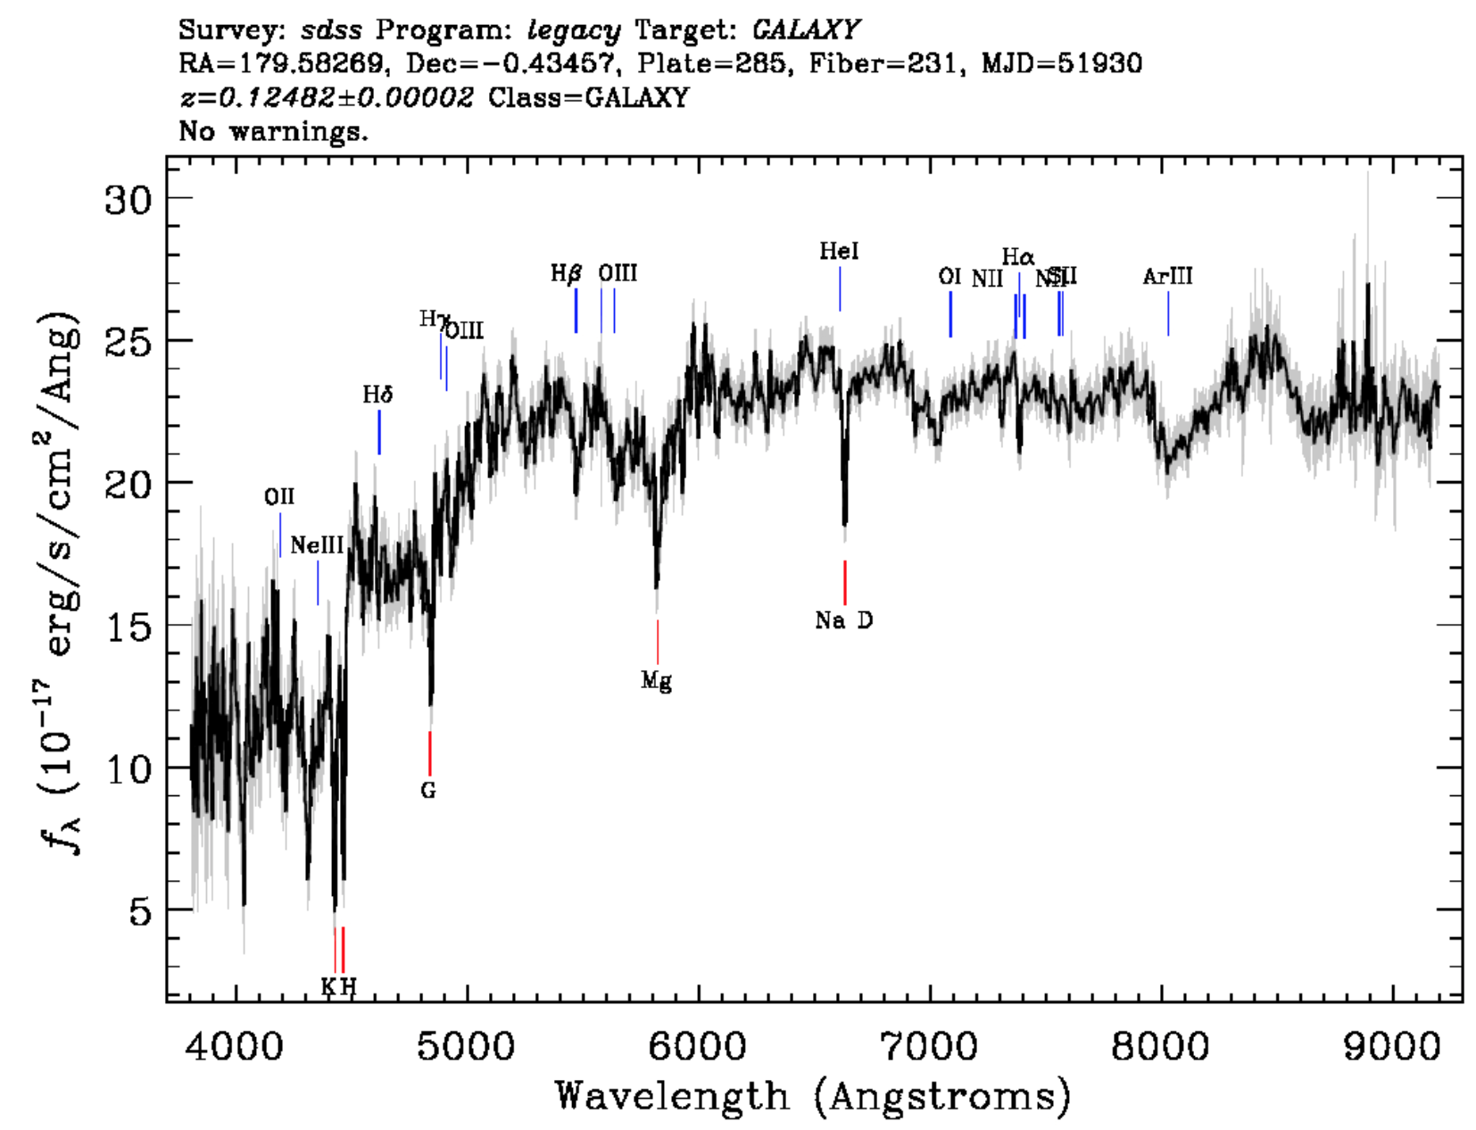
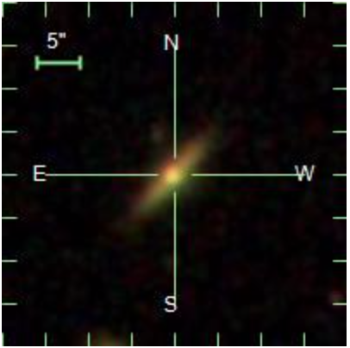
Example SDSS spectrum (low star formation rate galaxy at magnitude r = 17.14)

Slide 5
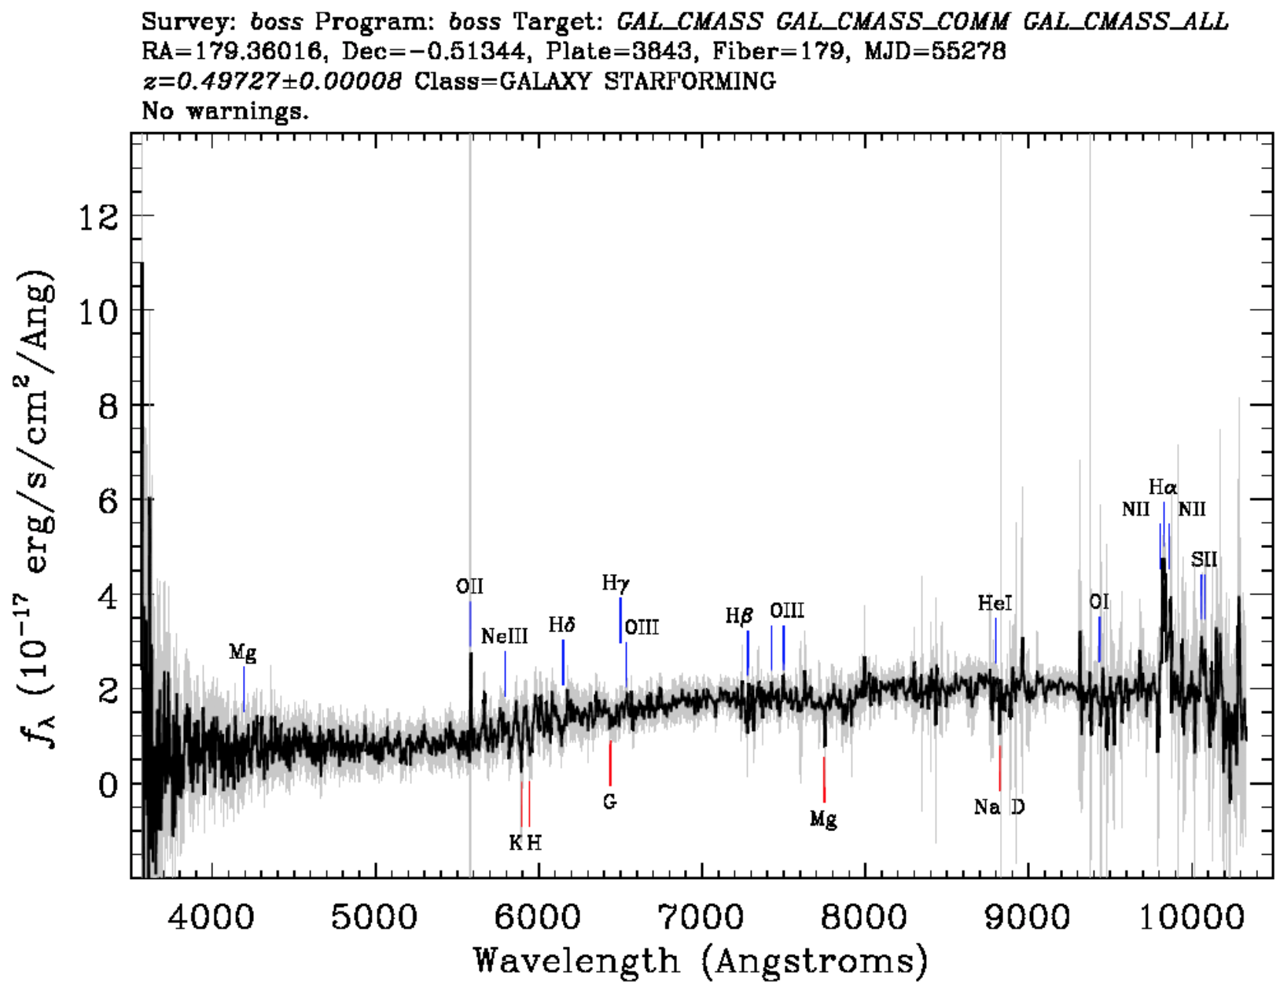
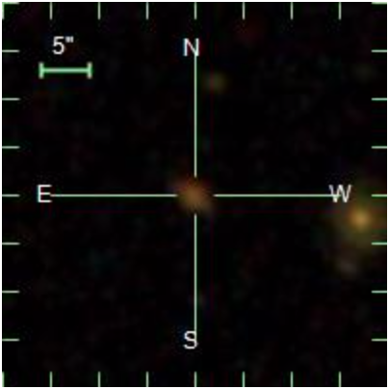
BOSS Target (luminous galaxy; turns out to be star-forming; r = 20.22)

Slide 6
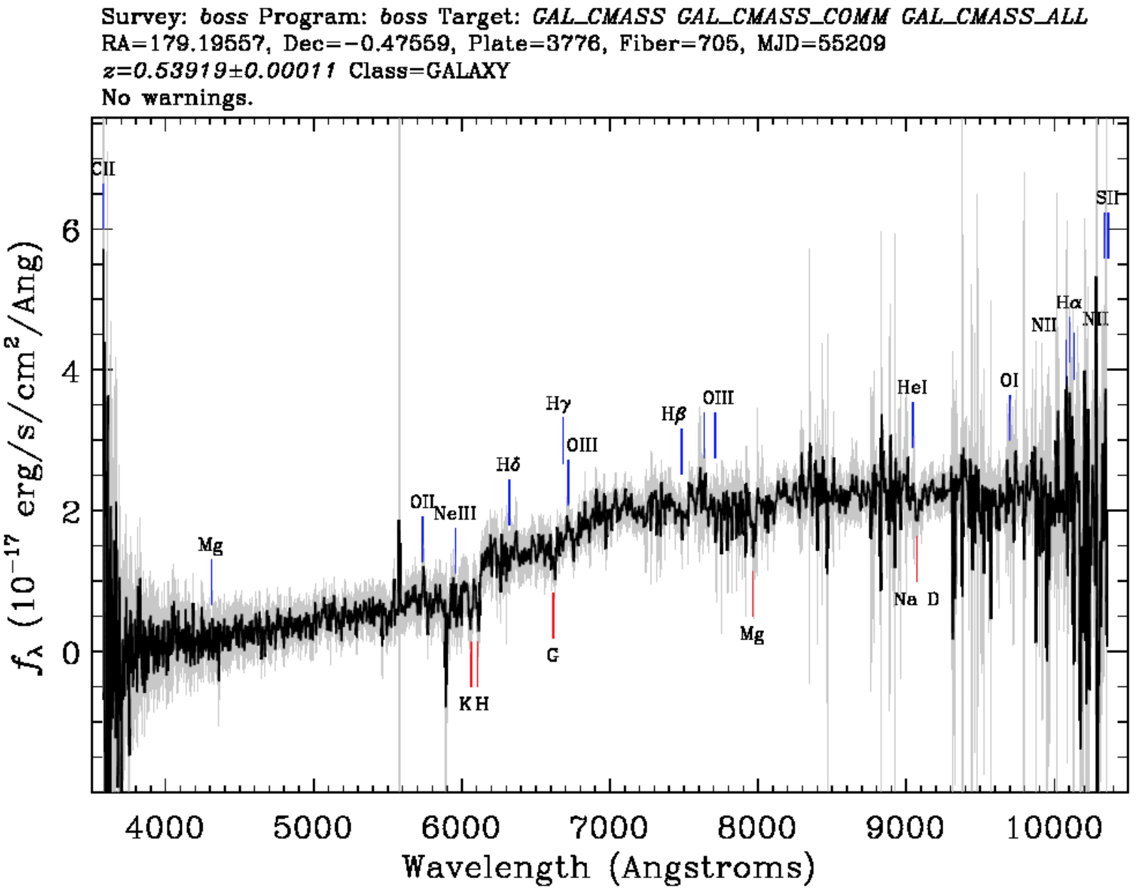
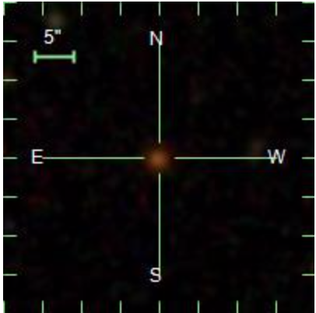
BOSS Target (luminous galaxy; not star-forming; r = 20.38)

Slide 7
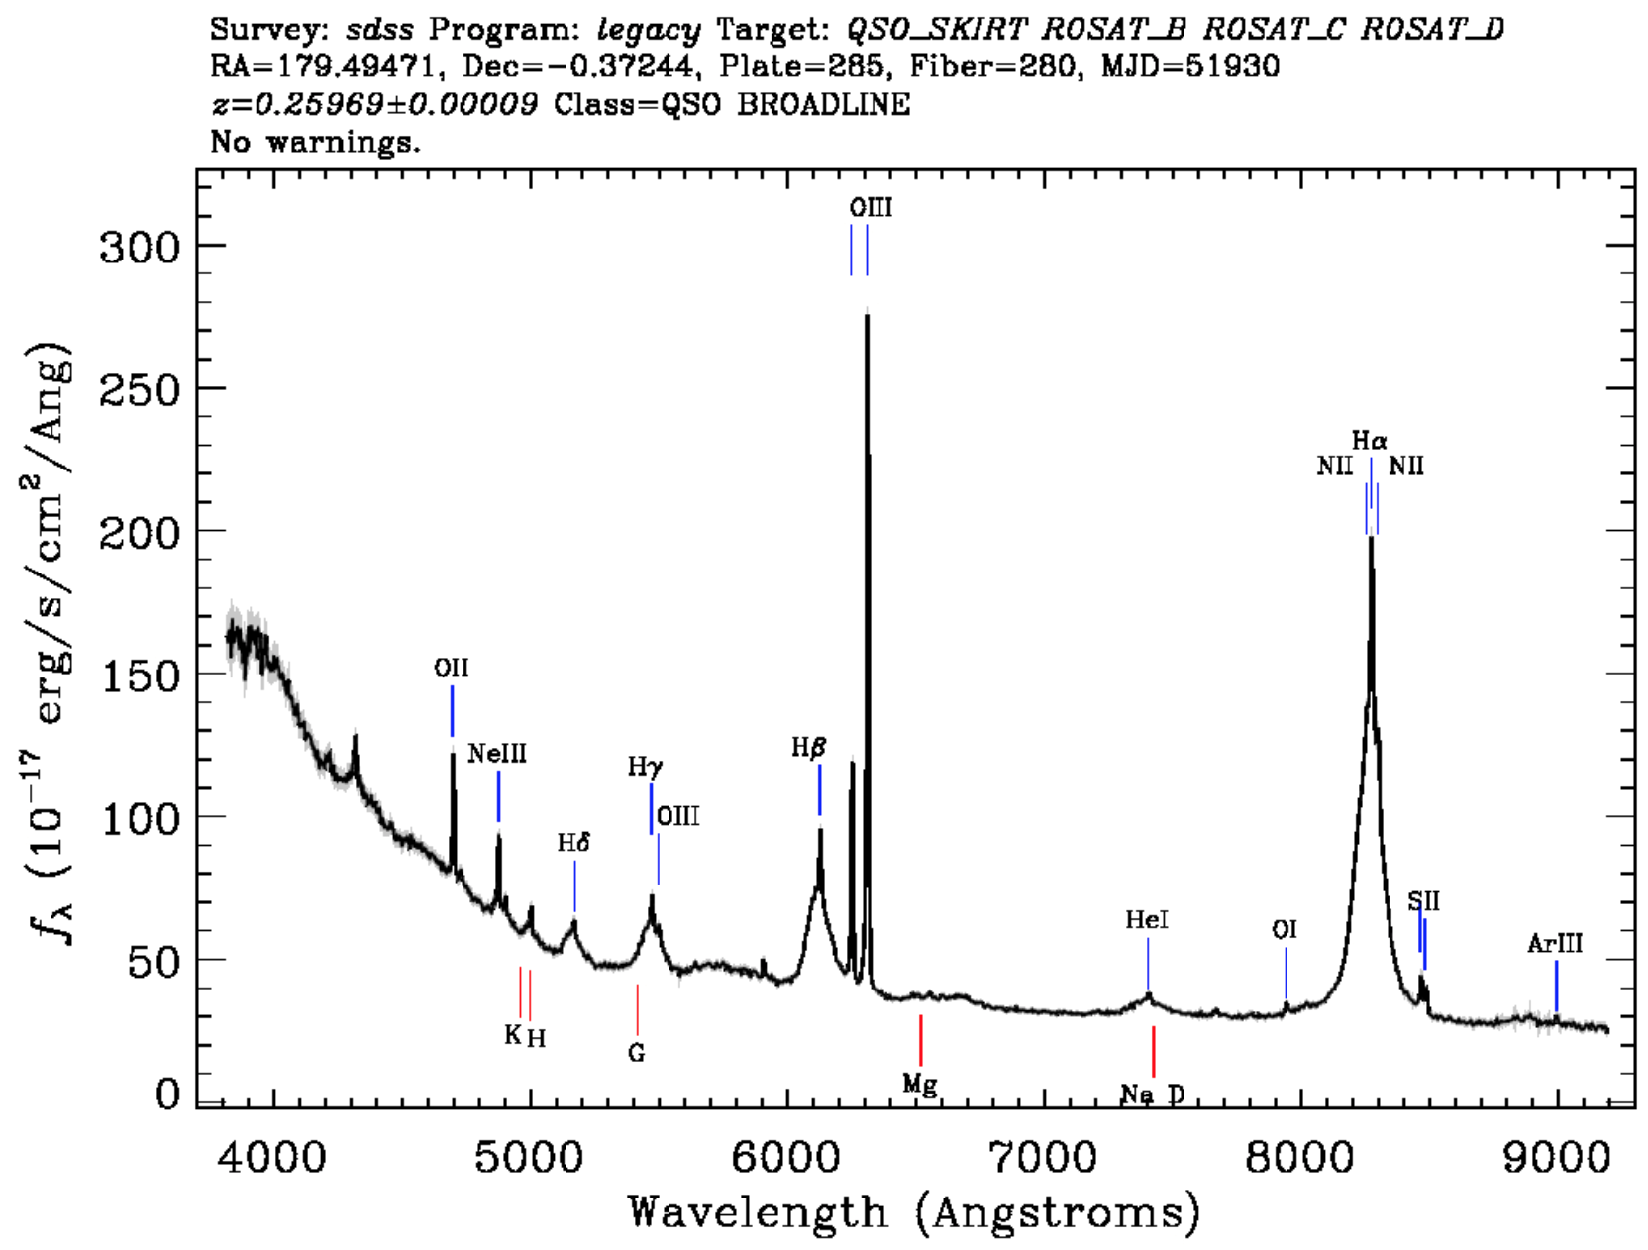
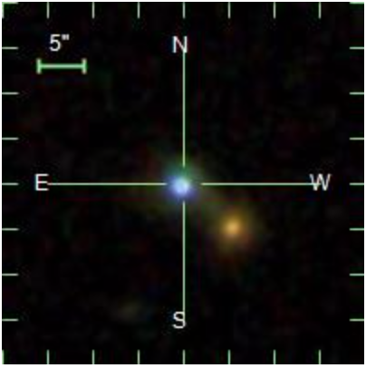
Low redshift quasar (magnitude g = 17.31)

Slide 8
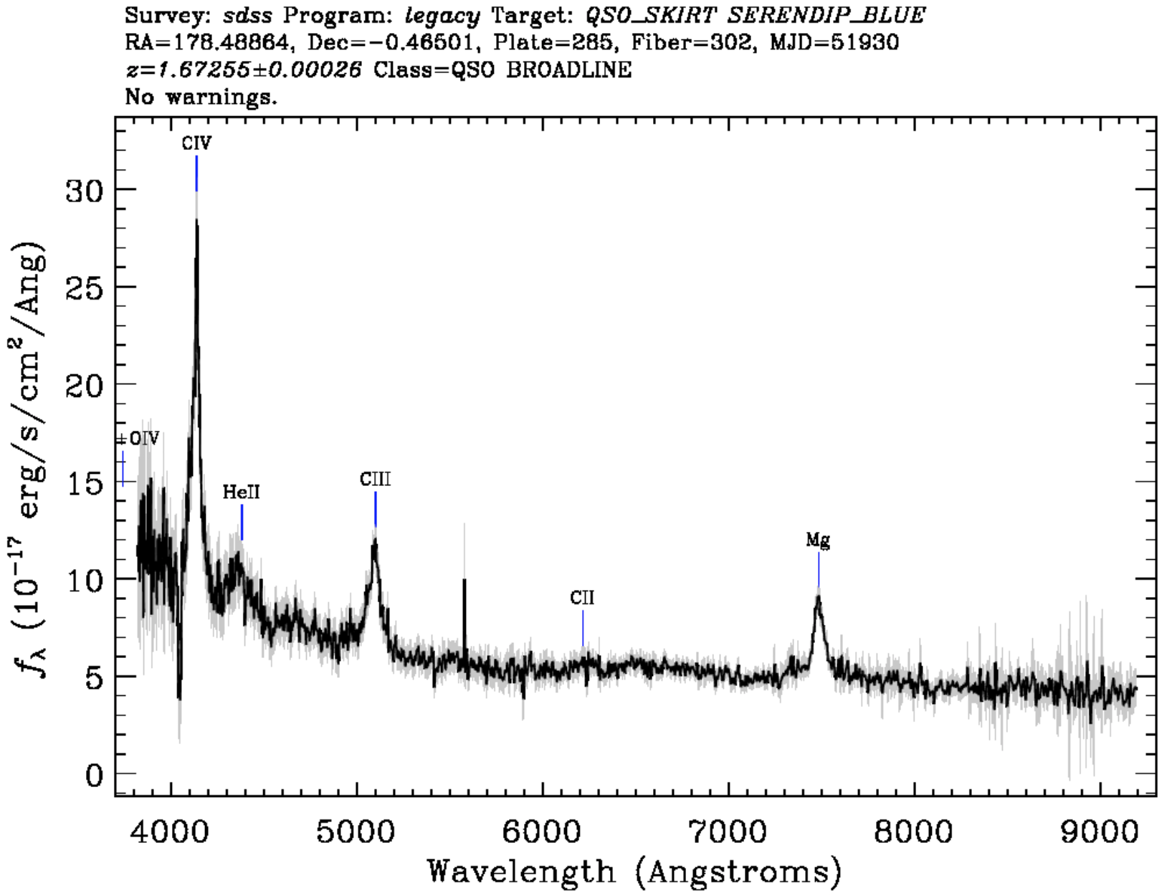
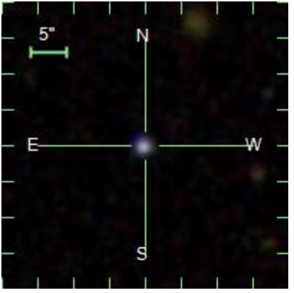
Medium redshift quasar (magnitude g = 19.48)

Slide 9
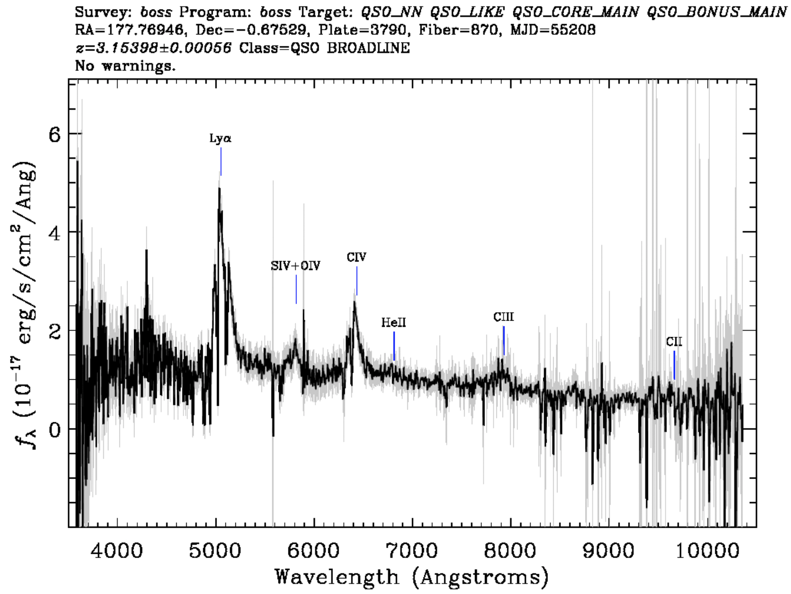
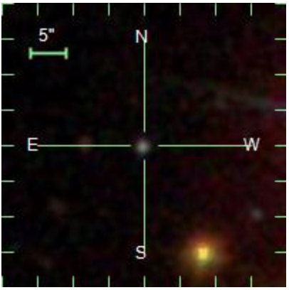
High redshift quasar (magnitude g = 21.01)

Slide 10
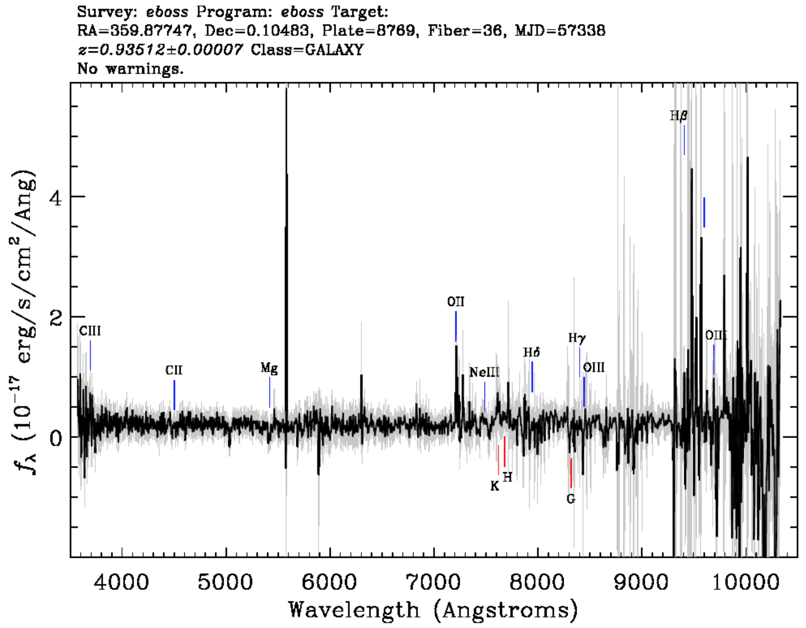
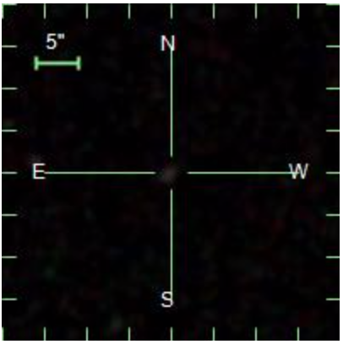
Emission line galaxy (eBOSS target, Nov. 12, 2015, r = 22.16)
(oxygen lines
from Earth’s atmosphere)
(this is the line that is from the galaxy: [O II] is the bluest of the bright nebular lines)
(OH subtraction residuals)

Slide 11
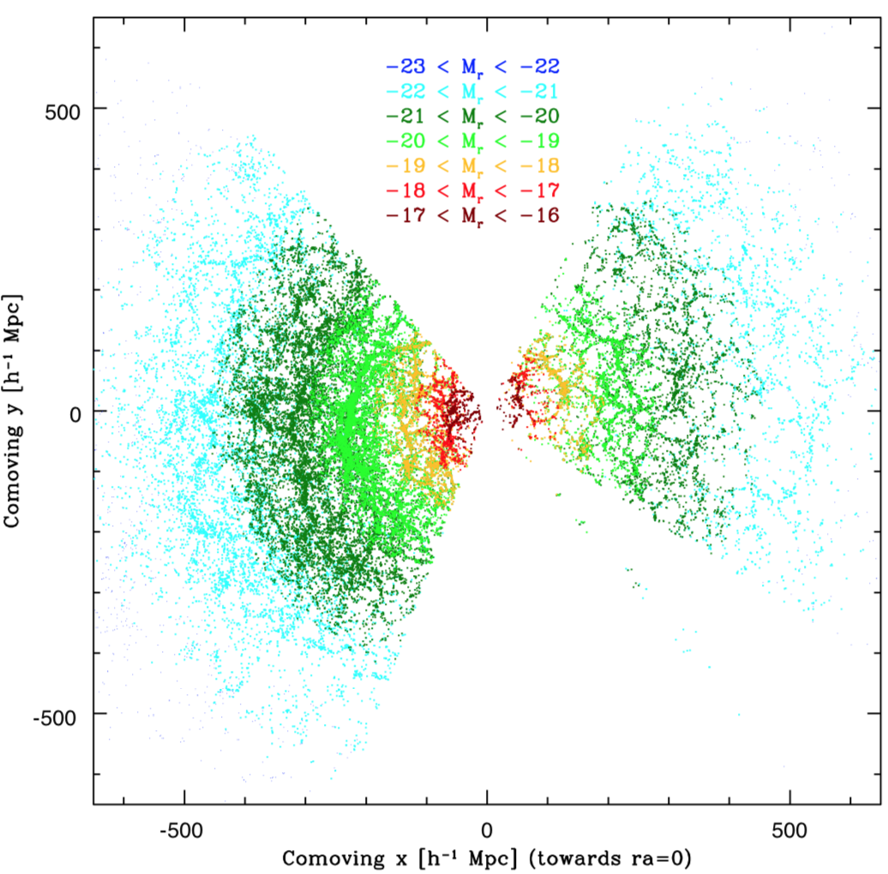
SDSS DR2 Sample
Tegmark et al. (2004)
(Figure goes out to z=0.2)

Slide 12
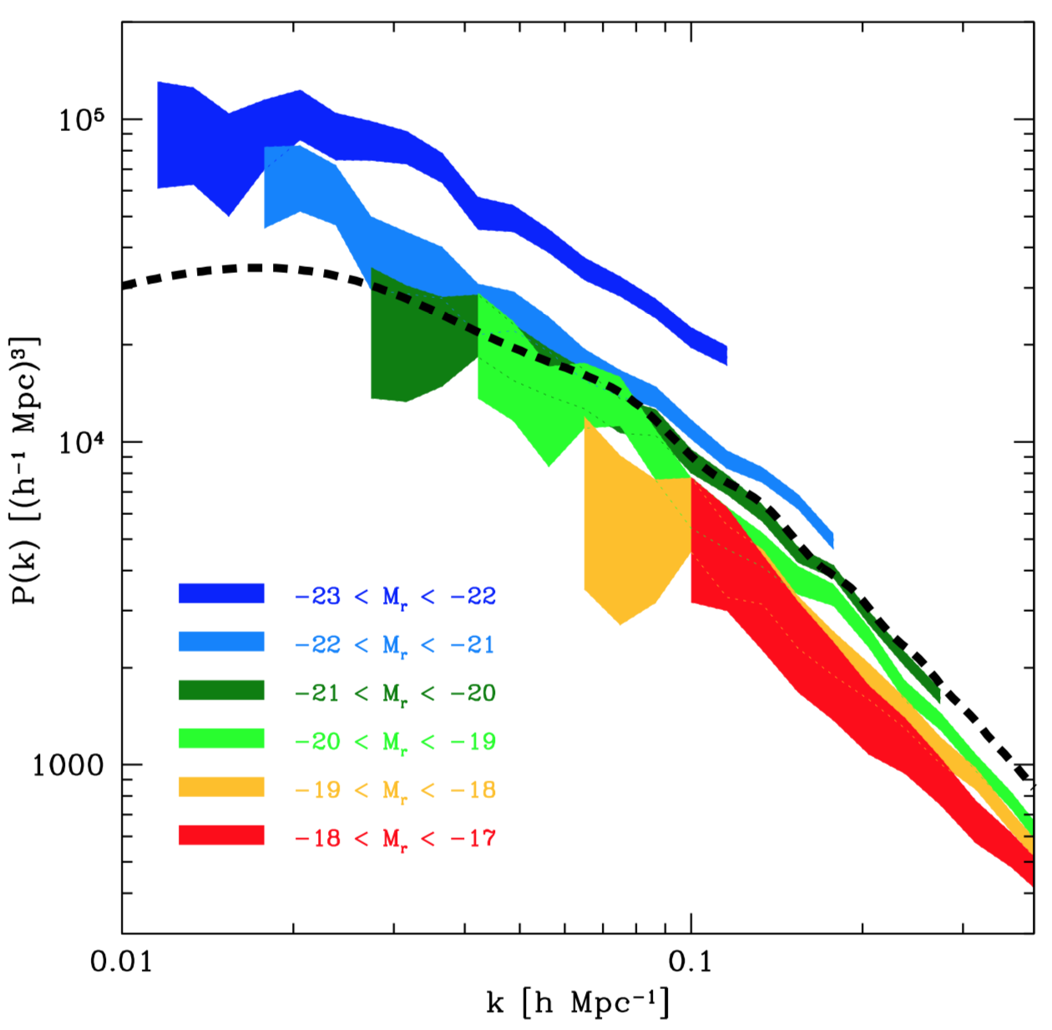
Galaxy power spectrum
split by absolute magnitude
(Tegmark et al. 2004)
high bias
low bias

Slide 13
Galaxy-Galaxy Lensing
SOURCE
Lens galaxy acts as a:
Converging lens in tangential direction
Diverging lens in radial direction
Mean distortion of source galaxy:
LENS
(See first detection by Brainerd, Blandford & Smail, 1996)

Slide 14
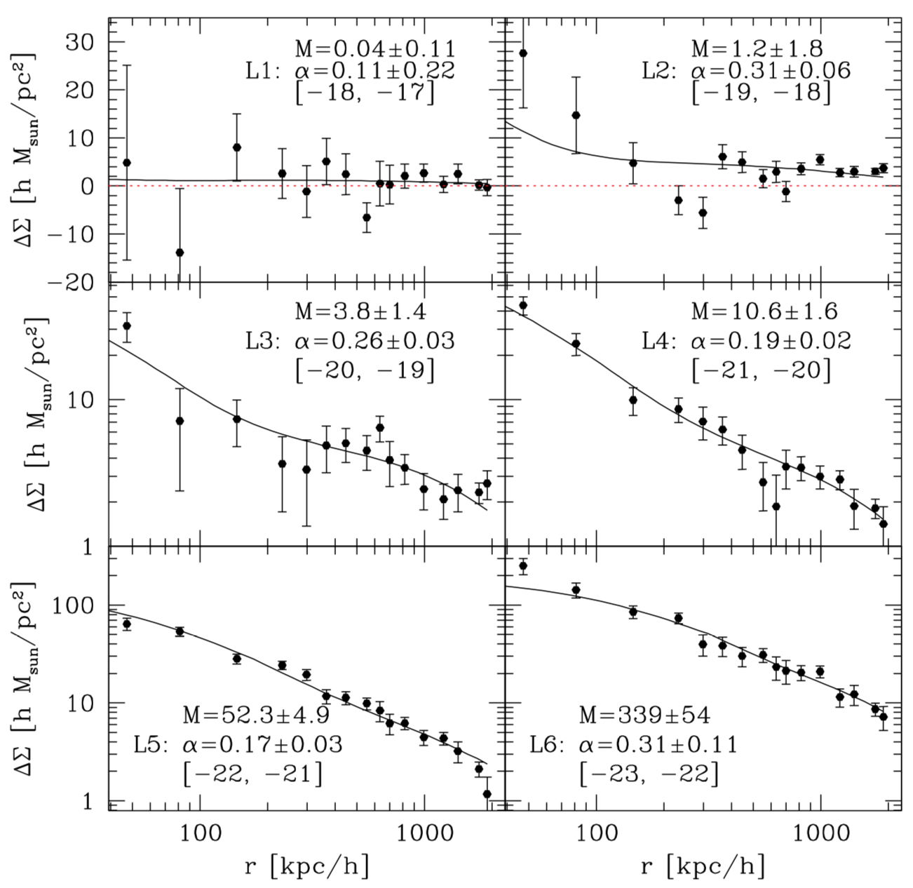
Weak lensing signals around galaxies
(Seljak et al. 2005)

Slide 15
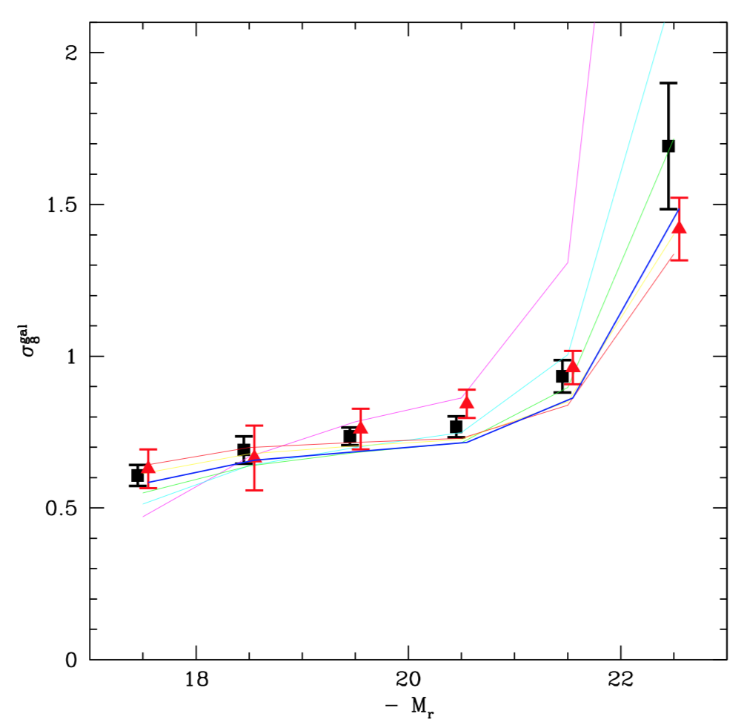
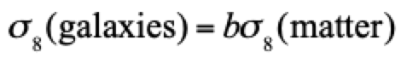
0.6
Clustering of galaxies:
Red triangles = observed
Black squares = predicted from weak lensing halo masses
Colored lines = different σ₈(matter)
(Seljak et al. 2005)
1.1

Slide 16
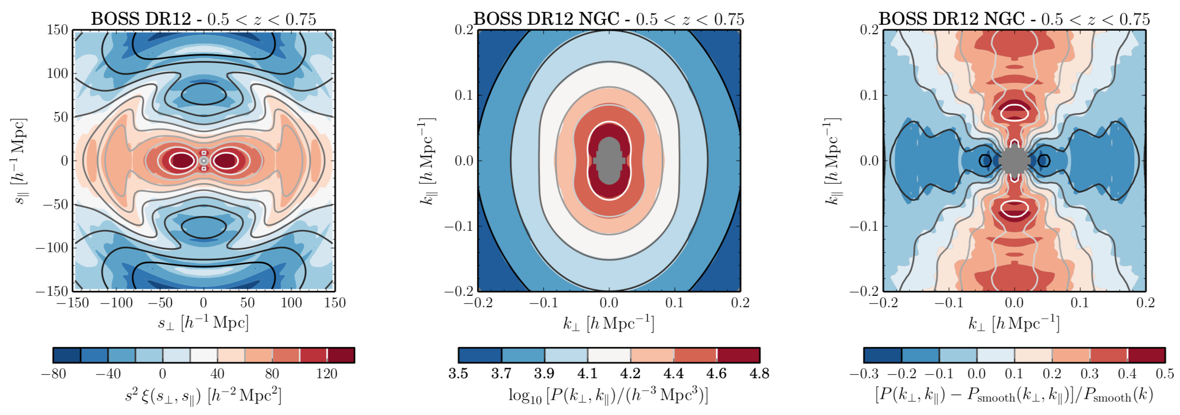
Statistics from BOSS (0.5<z<0.75 sample; Alam et al. 2017)
Power spectrum
(smooth component removed)
Correlation function
Power spectrum

Slide 17
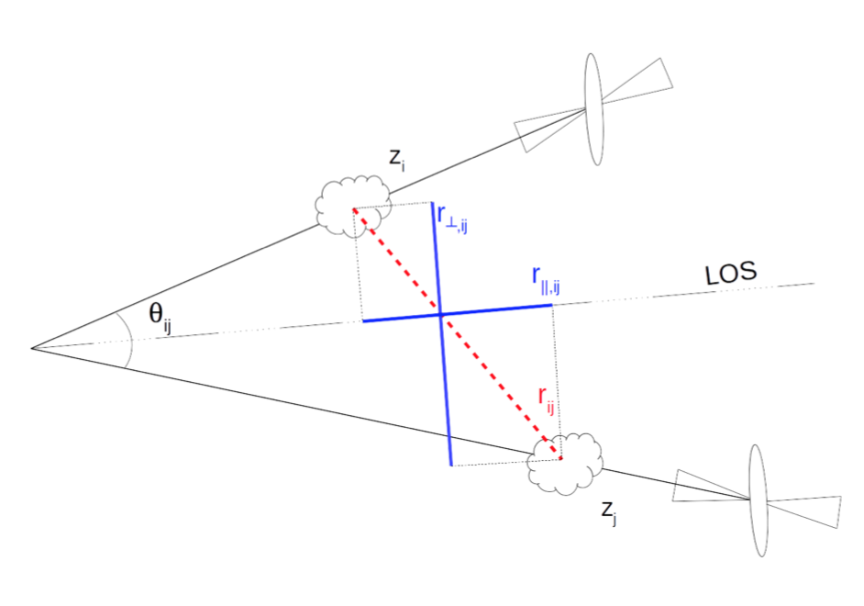
Lyman-α forest in 3D
µ = cos(this angle)
Saint Agathe et al. (2019)
(θ_{ij} is exaggerated)

Slide 18
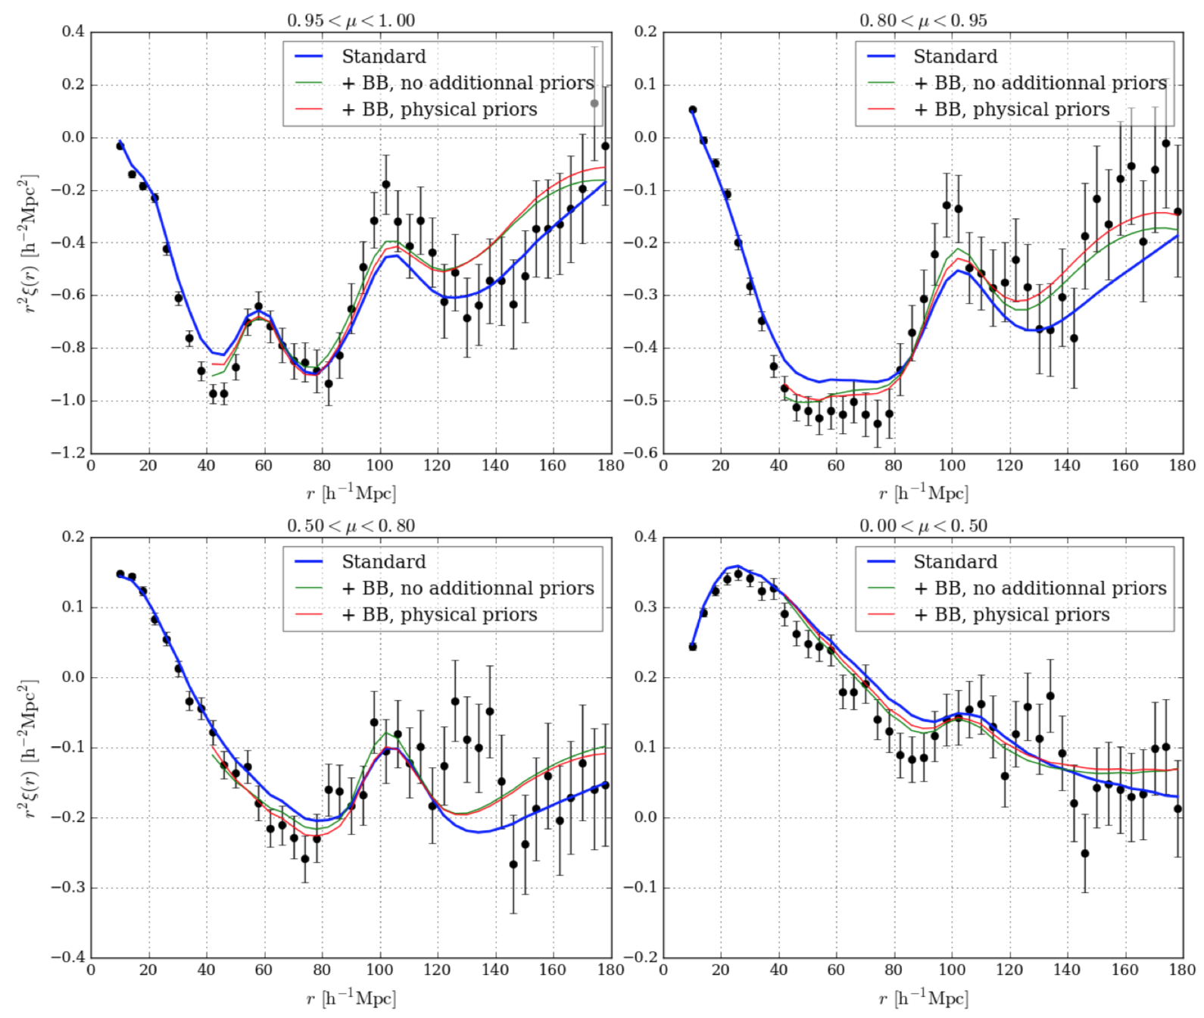
Lyα x Si II
BAO
Saint Agathe et al. (2019)

Slide 19
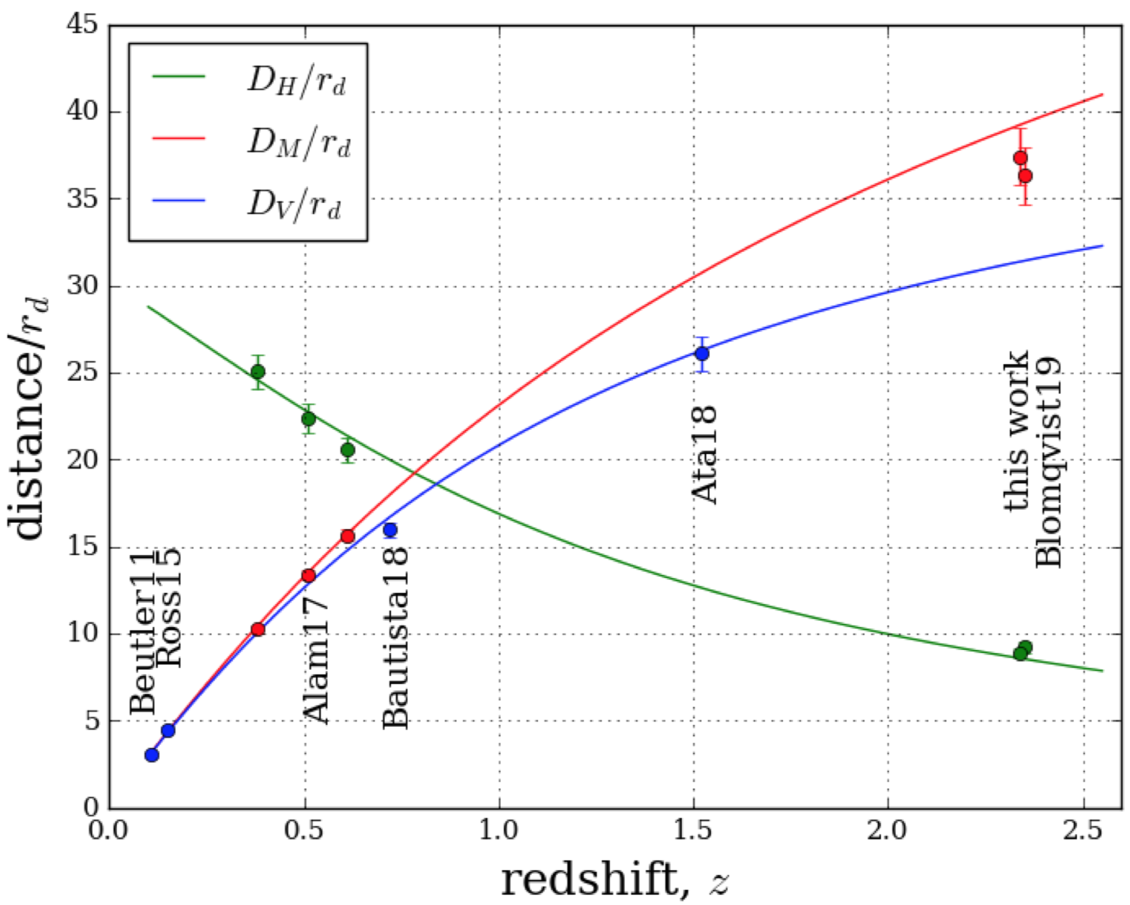
BAO CURRENT STATUS
(de Sainte Agathe et al., 2019)
transverse
isotropic
quasars
galaxies
radial
Lyman-α forest
+ quasars

Slide 20
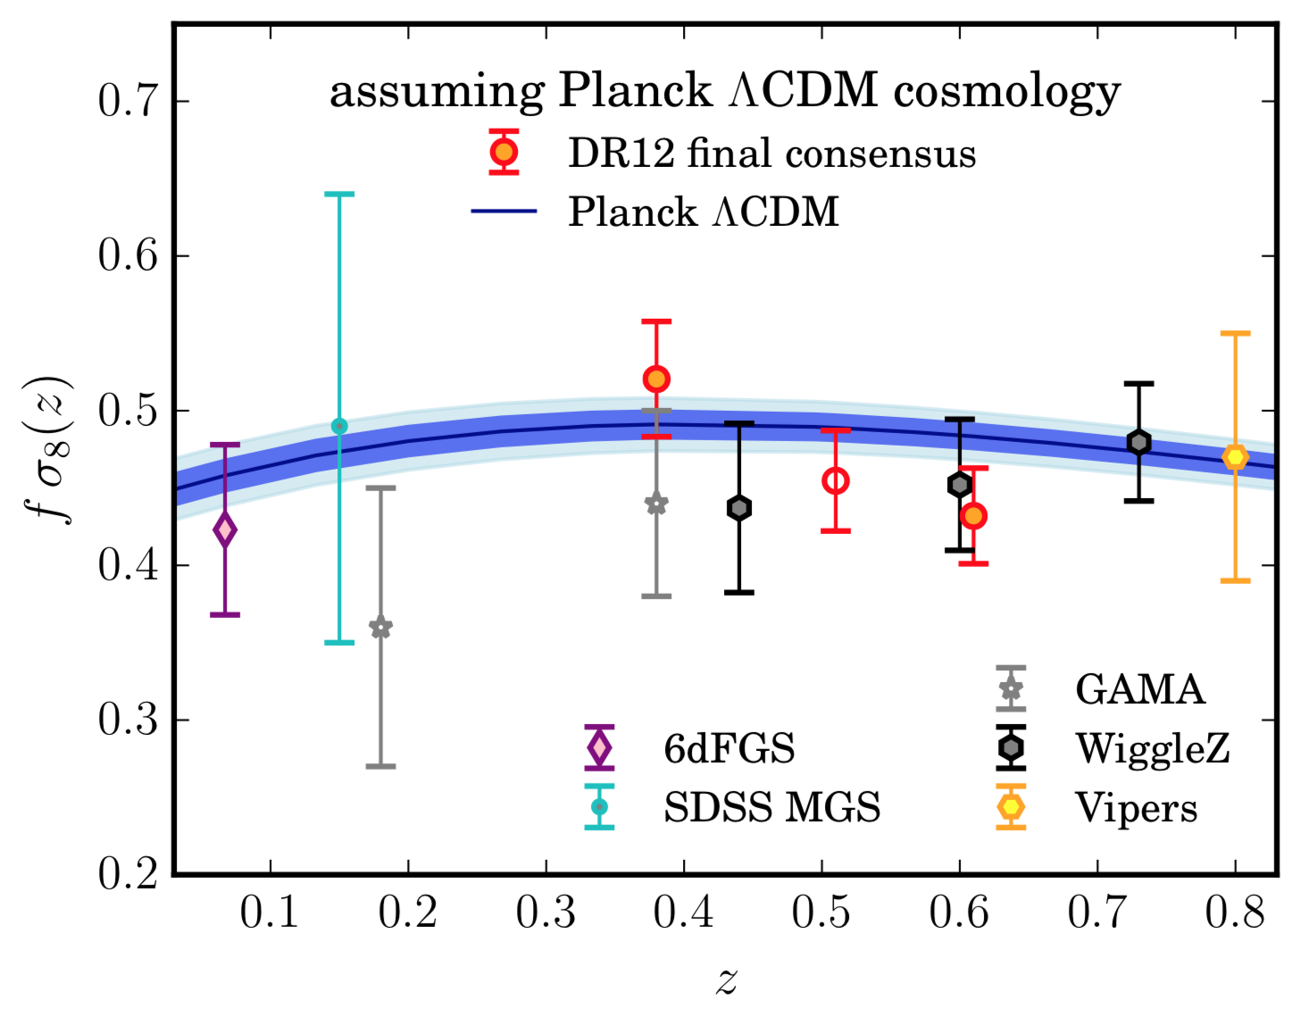
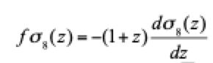
Growth of Structure from Redshift Space Distortions (Alam et al. 2017)
(background is Planck ΛCDM)

